Slide 1
Introduction to Machine Learning
Definition of Machine Learning (ML)
Differences between AI, ML, and Deep Learning
Real-world applications of ML (e.g., image recognition, natural language processing, recommendation systems)

Slide 2
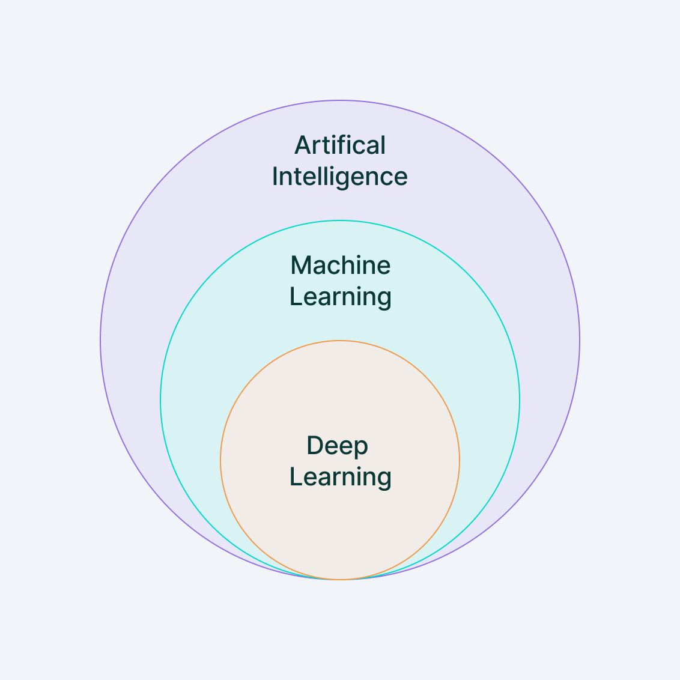
Machine Learning
Machine Learning (ML) is a branch of artificial intelligence (AI) that focuses on building systems that can learn from data, identify patterns, and make decisions with minimal human intervention.
In essence, machine learning allows computers to "learn" from past experiences (data) and improve their performance over time without being explicitly programmed for every possible scenario.
https://www.v7labs.com/blog/machine-learning-guide

Slide 3
Machine Learning: Applications
Image Recognition:
Facial Recognition: Used in smartphones, social media platforms (e.g., Facebook photo tagging), and security systems. ML algorithms can detect and recognize human faces in images or videos.
Medical Imaging: ML is used in analyzing X-rays, MRIs, and CT scans to identify abnormalities such as tumors, fractures, or other diseases.
Object Detection: Used in autonomous vehicles, retail (e.g., Amazon Go stores), and security surveillance systems.

Slide 4
Machine Learning: Applications
Speech and Voice Recognition:
Virtual Assistants: ML powers virtual assistants like Siri, Alexa, and Google Assistant, enabling them to recognize and respond to voice commands.
Speech-to-Text: Applications like Google Voice Typing and automated transcription services convert spoken words into written text.
Voice Biometrics: Used in security systems for identifying individuals based on their voice.

Slide 5
Machine Learning: Applications
Natural Language Processing (NLP):
Chatbots and Customer Support: ML-driven chatbots can understand and respond to customer queries, improving customer service for companies like banks, e-commerce platforms, and service providers.
Language Translation: Google Translate and other language translation apps use ML models to translate text and speech between different languages.
Sentiment Analysis: Businesses use ML to analyze customer reviews, social media posts, and other text data to determine public sentiment or opinions about products or services.

Slide 6
Machine Learning: Applications
Recommendation Systems:
E-commerce: Platforms like Amazon and Alibaba use ML to recommend products based on a user’s browsing history, purchase behavior, and preferences.
Streaming Services: Netflix, Spotify, and YouTube recommend movies, music, and videos by analyzing user interactions, viewing history, and preferences.
Social Media: Facebook, Twitter, and Instagram use recommendation algorithms to suggest friends, posts, or content that align with a user’s interests.

Slide 7
Machine Learning: Applications
Fraud Detection:
Banking and Finance: ML algorithms analyze transaction patterns to detect fraudulent activities, such as credit card fraud, money laundering, or account takeovers.
Insurance: Insurers use ML to detect fraudulent insurance claims by spotting unusual patterns or behaviors in claim submissions.
Autonomous Vehicles:
Self-Driving Cars: Companies like Tesla, Waymo, and Uber use ML to help autonomous vehicles interpret their surroundings (e.g., detecting pedestrians, road signs, and other cars), make driving decisions, and navigate safely.
Drone Navigation: ML is used in drones for route planning, object detection, and collision avoidance.

Slide 8
Machine Learning: Applications
Healthcare and Medical Diagnosis:
Disease Prediction: ML models help predict the likelihood of diseases such as diabetes, heart disease, or cancer by analyzing patient data.
Personalized Medicine: Machine learning enables the development of personalized treatment plans based on a patient's genetics, medical history, and current health data.
Drug Discovery: ML accelerates the process of discovering new drugs by analyzing data from clinical trials and identifying potential drug candidates.
More….
Finance and Stock Market Analysis
Marketing and Advertising
Supply Chain Optimization
Gaming, Robotics, Cybersecurity
Personalization
Energy Efficiency

Slide 9
Types of Machine Learning
Supervised Learning
Unsupervised Learning
Semi-supervised Learning
Reinforcement Learning

Slide 10
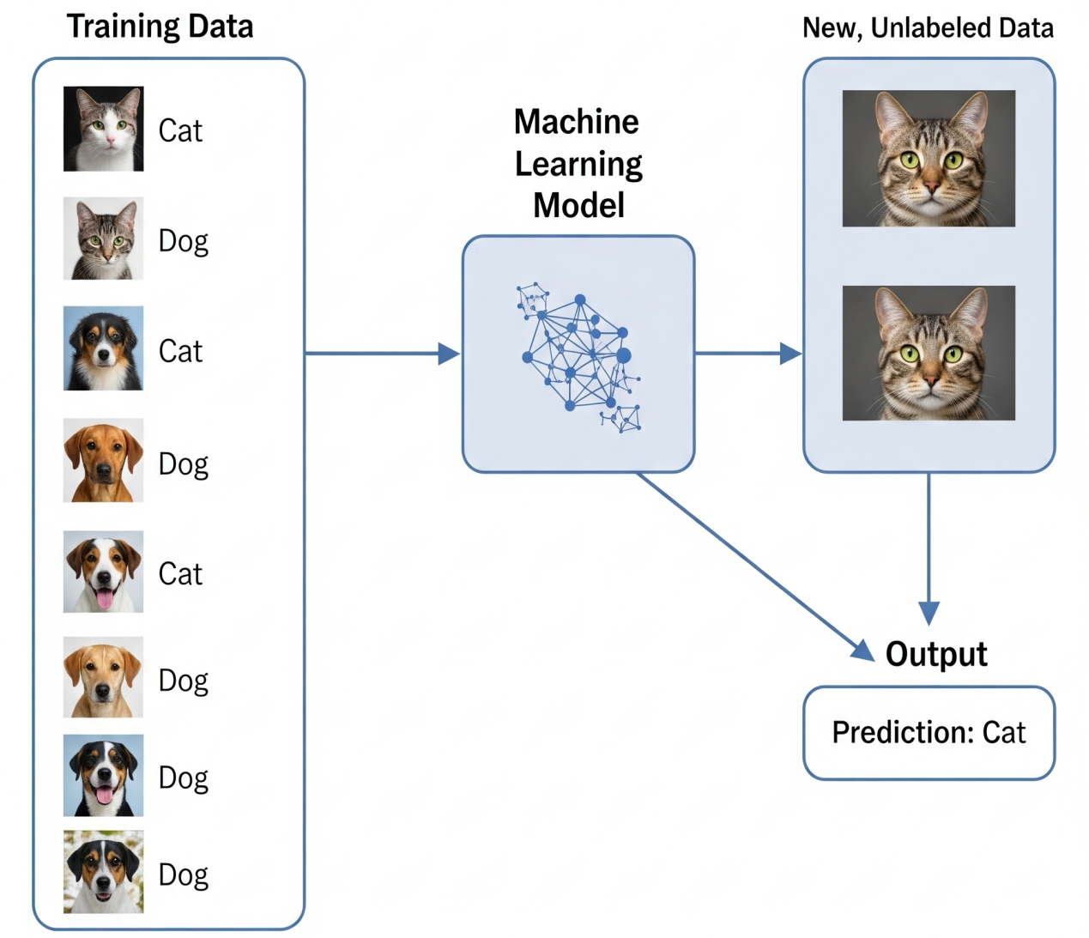
Types of Machine Learning
Supervised Learning
In supervised learning, the model is trained on labeled data, meaning that each training example has both input data and a corresponding correct output (label).
The goal is for the model to learn the mapping from inputs to outputs so that it can predict the output for new, unseen data.

Slide 11
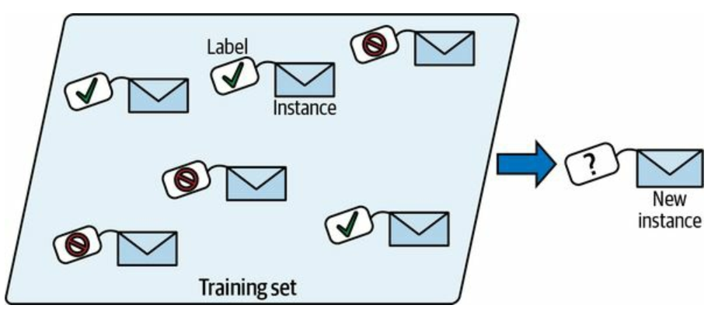
Types of Machine Learning
Supervised Learning
In supervised learning, the model is trained on labeled data, meaning that each training example has both input data and a corresponding correct output (label).
The goal is for the model to learn the mapping from inputs to outputs so that it can predict the output for new, unseen data.
Example: Spam detection in emails, where the model is trained on labeled emails (spam or not spam).

Slide 12
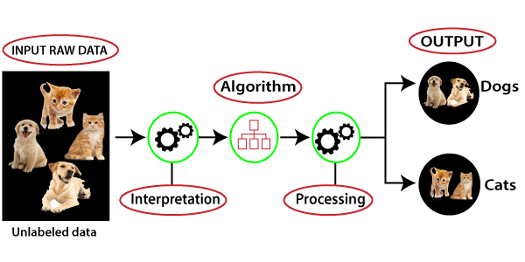
Types of Machine Learning
Unsupervised Learning
In unsupervised learning, the model is given data without explicit labels. It tries to learn the structure of the data and discover hidden patterns or groupings.
Example: Customer segmentation, where the goal is to group customers based on purchasing behavior without knowing any predefined categories.
https://www.javatpoint.com/unsupervised-machine-learning

Slide 13
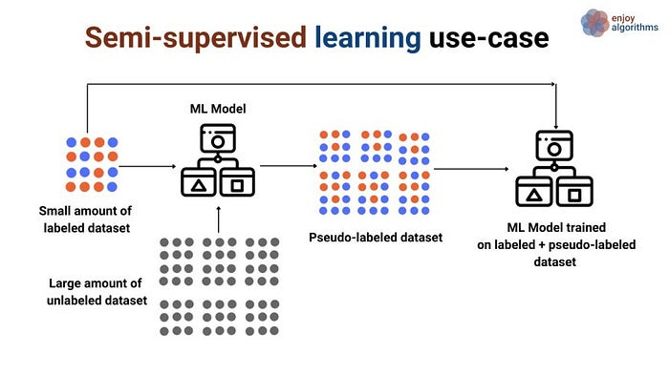
Types of Machine Learning
Semi-supervised Learning
This method uses a small amount of labeled data combined with a large amount of unlabeled data. The model leverages the unlabeled data to improve its learning efficiency.
Example: Image classification where only a few images are labeled, but many unlabeled images are available.
https://medium.com/@gayatri_sharma/a-gentle-introduction-to-semi-supervised-learning-7afa5539beea

Slide 14
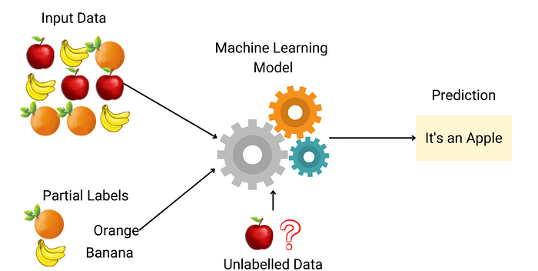
Types of Machine Learning
Semi-supervised Learning
This method uses a small amount of labeled data combined with a large amount of unlabeled data. The model leverages the unlabeled data to improve its learning efficiency.
Example: Image classification where only a few images are labeled, but many unlabeled images are available.
https://medium.com/@gayatri_sharma/a-gentle-introduction-to-semi-supervised-learning-7afa5539beea

Slide 15
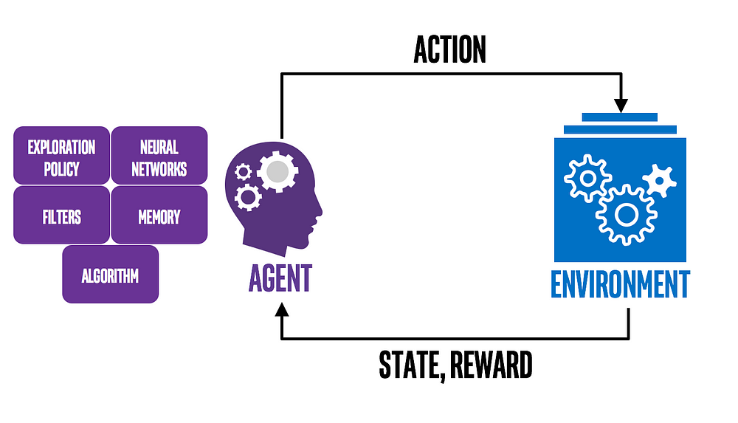
Types of Machine Learning
Reinforcement Learning
In reinforcement learning, an agent interacts with an environment and learns by receiving feedback in the form of rewards or penalties. The agent aims to maximize cumulative rewards by learning the optimal set of actions to take in different situations.
Example: Training a robot to navigate through a maze by rewarding it for reaching the end.
https://medium.com/ai%C2%B3-theory-practice-business/reinforcement-learning-part-1-a-brief-introduction-a53a849771cf

Slide 16
Types of Machine Learning
Reinforcement Learning: Example
Determining the Placement of Ads on a Web Page
Agent: The program making decisions on how many ads are appropriate for a page.
Environment: The web page.
Action: One of three:
(1) putting another ad on the page;
(2) dropping an ad from the page;
(3) neither adding nor removing.
Reward: Positive when revenue increases; negative when revenue drops.
In this scenario, the agent observes the environment and gets its current status. The status can be how many ads there are on the web page and whether or not there is room for more.
The agent then chooses which of the three actions to take at each step. if programmed to get positive rewards whenever the revenue increase, and negative rewards whenever revenue falls, it can develop its effective policy.
https://medium.com/ai%C2%B3-theory-practice-business/reinforcement-learning-part-1-a-brief-introduction-a53a849771cf

Slide 17
Types of Machine Learning
Supervised, Unsupervised, and Reinforcement Learning: What are the Differences?
Difference #1: Static Vs. Dynamic
The goal of supervised and unsupervised learning is to search for and learn about patterns in training data, which is quite static. RL, on the other hand, is about developing a policy that tells an agent which action to choose at each step — making it more dynamic.
Difference #2: No Explicit Right Answer
In supervised learning, the right answer is given by the training data. In Reinforcement Learning, the right answer is not explicitly given: instead, the agent needs to learn by trial and error. The only reference is the reward it gets after taking an action, which tells the agent when it is making progress or when it has failed.
https://medium.com/ai%C2%B3-theory-practice-business/reinforcement-learning-part-1-a-brief-introduction-a53a849771cf

Slide 18
Key Concepts in Machine Learning
Data and Features: input data, features, labels
Model and Algorithm: what is a model, common ML algorithms
Training and Testing: data splitting (train-test-validation sets)
Loss Function: error measurement, cost function
Optimization: gradient descent basics

Slide 19
Learning Process
How a model learns: data → algorithm → model
Model evaluation metrics: accuracy, precision, recall, F1 score
Overfitting and underfitting: bias-variance tradeoff

Slide 20
Fundamental Algorithms Overview
Linear Regression
Logistic Regression
Decision Trees
k-Nearest Neighbors (k-NN)
Briefly introduce more advanced methods (e.g., Neural Networks, Support Vector Machines)

Slide 21
Challenges in Machine Learning
Data quality and quantity
Feature engineering and selection
Interpretability and explainability of models
Scalability and performance

